Slide 1
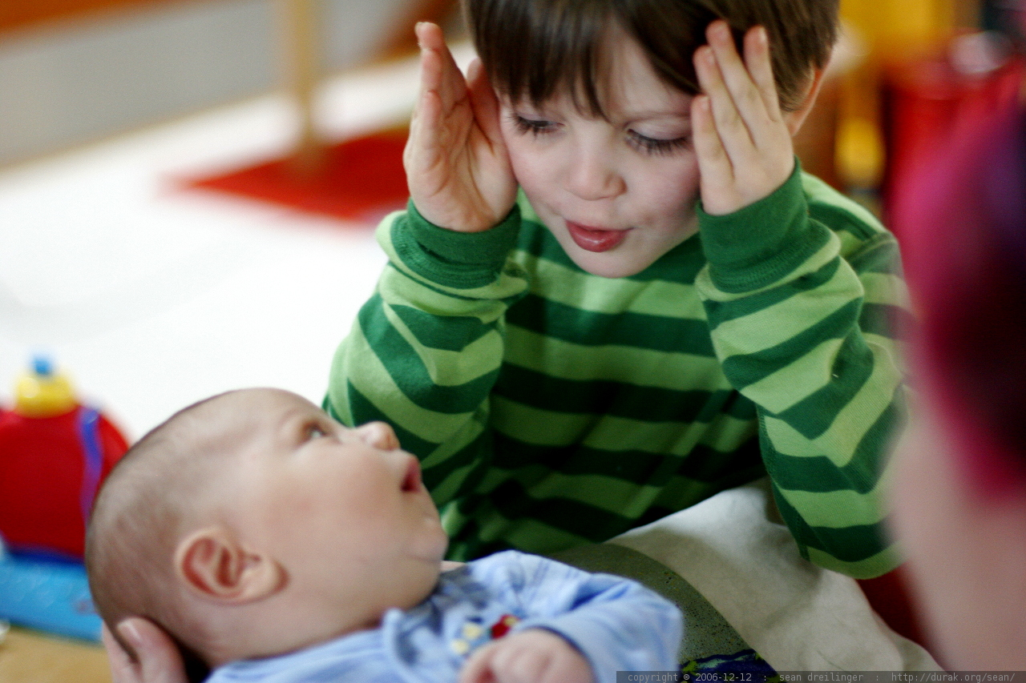
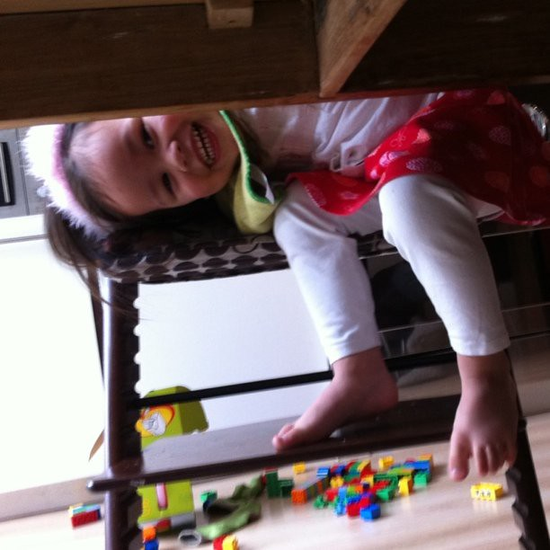
Peek-A-Boo

Slide 2
How do you feel?
Remember last week we talked about emotions.
Have the child repeat the following words:
Happy
Sad
Excited
Scared
*Have the child act out each expression.

Slide 3
Peek-A-B00
This week we will focus on your child curiosity.
Do the following:
Put your hands or a blanket and say, “Peek-A-Boo.” Look at the child’s facial expressions. Look to see if the child’s eyes are following you.
This Photo by Unknown Author is licensed under CC BY

Slide 4
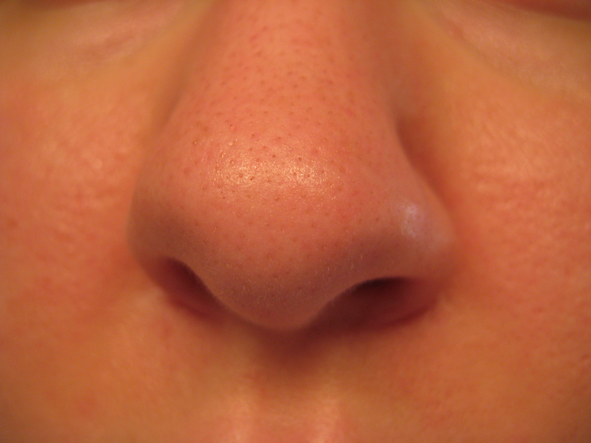
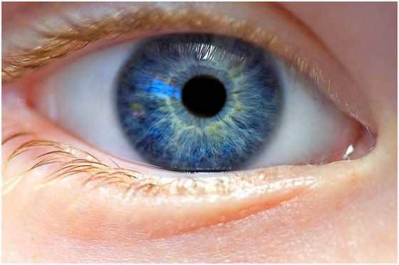
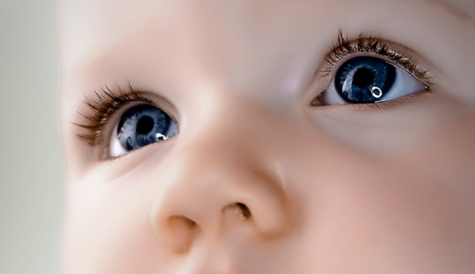
Who’s Eyes
Let’s focus on finding the eyes!
Have the child point to the eyes.

Slide 5
Tell your child to blink your eyes.

Slide 6
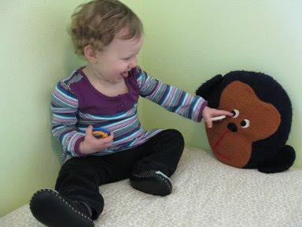
Let’s point to your eyes

Slide 7
EYES
As you may have guessed, we are working on our five senses. The first sense sight. We want your child to be able to recognize their eyes on command. During the day ask your child to point to their eyes or your eyes. When they point correctly give them lots of praises.
Also tell your child the purpose of eyes. Yes, they help us see!

Slide 8
Story Time
https://www.youtube.com/watch?v=mzF5xy5YrS0

Slide 9
Family Activity
This Photo by Unknown Author is licensed under CC BY-SA

Slide 10
Peek A Boo
Get creative with peek a boo games by employing different props.
For example, hide under a scarf or blanket and pop out unexpectedly, or encourage your tot to pull the blanket off himself. Place your child's favorite stuffed animal over your face, then pull it away. Use a paper plate as a mask or place a box over your head. Add interest by making a different silly sound each time your face is revealed, or begin to sing one of your tot's favorite songs and abruptly stop when you recover your face.

Slide 11
Push-up-Boo
You can use an old yogurt cup, or anything resembling one to place an object such as:
Dog
Cat
Your picture or family picture
Favorite cartoon character
As you push up the prop say, “Pick-A-Boo” what do you see?

Slide 12
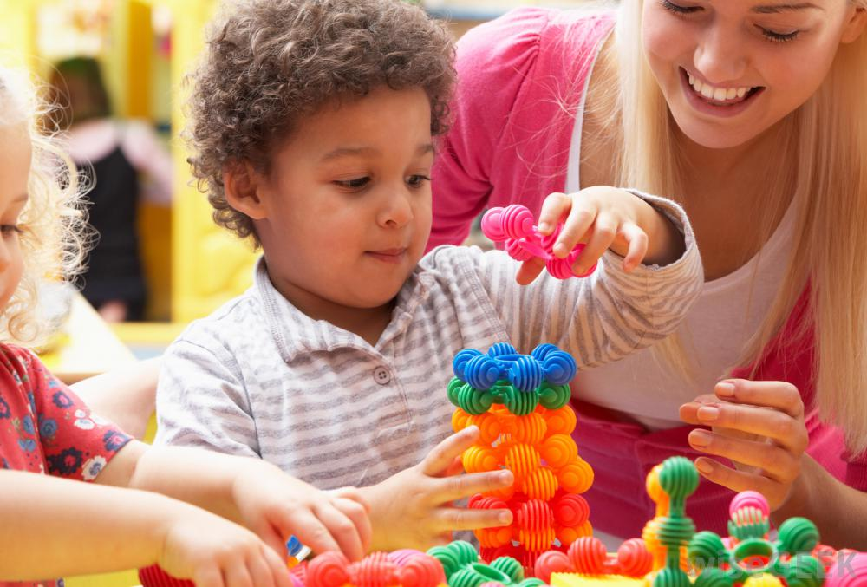
Milestones Where is my baby?
We must remember that all children learn at different paces. The link to your left is a great website to ensure that your children are developing at a steady pace.
https://www.verywellfamily.com/what-is-a-developmental-milestone-2795123

Slide 13
Table Talk
Mom/Dad, how are ok?
Remember to make sure your child’s immunization record is updated on their Early Periodic Screening Diagnosis Treatment (EPSDT).

Slide 14
Additional Resources
https://www.youtube.com/watch?v=sIY_xjYGHus
Developmental milestones for 11 months old
https://www.youtube.com/watch?v=7e7QzOVKl-Y
Developmental toys DYI for Babies to toddlers
https://www.youtube.com/watch?v=C0fsIMCjVkM&list=PL8TioFHubWFsRMZjkCVj_H3Q-Hwc27iva
Elmo Eye Spy

Slide 15
References
https://howtoadult.com/peek-boo-games-toddlers-13014.html
https://www.verywellfamily.com/what-is-a-developmental-milestone-2795123
YouTube
https://www.youtube.com/watch?v=sIY_xjYGHus
Developmental milestones for 11 months old
https://www.youtube.com/watch?v=7e7QzOVKl-Y
Developmental toys DYI for Babies to toddlers
https://www.youtube.com/watch?v=C0fsIMCjVkM&list=PL8TioFHubWFsRMZjkCVj_H3Q-Hwc27iva
Elmo Eye Spy
https://www.youtube.com/watch?v=mzF5xy5YrS0

